Slide 1
HW5 – RISC CPU
Mark Dannemiller

Slide 2
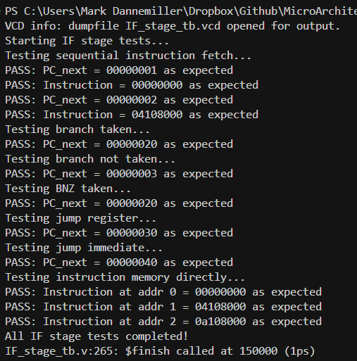
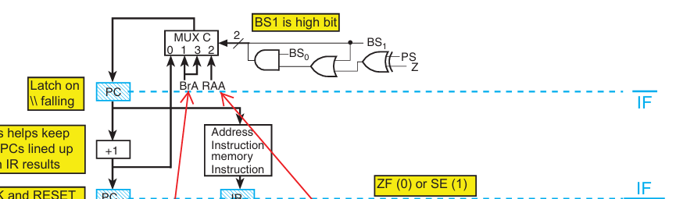
IF Stage Unit Testbench
Tests sequential fetching, branching, branching not 0, jump based on register, jump based on immediate, and testing preset instruction memory persists

Slide 3
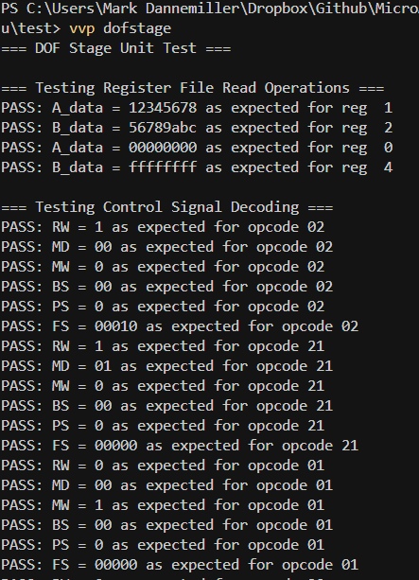
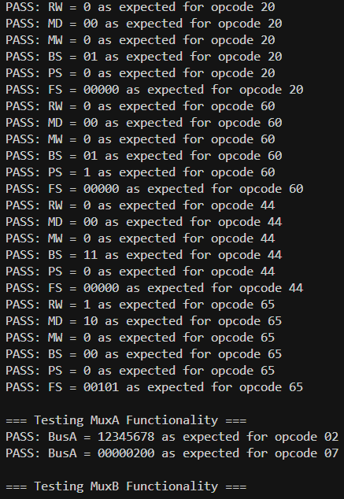
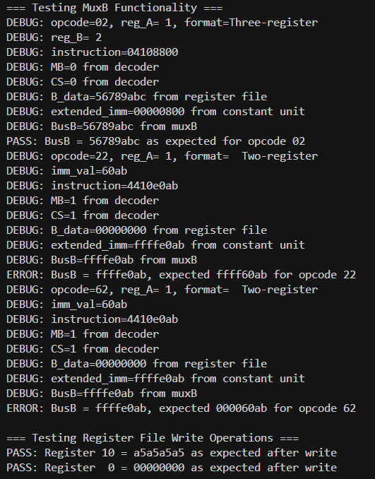
DOF Stage Unit Testbench
Test Register reads, Opcode -> control registers, constant unit, and multiplexers

Slide 4
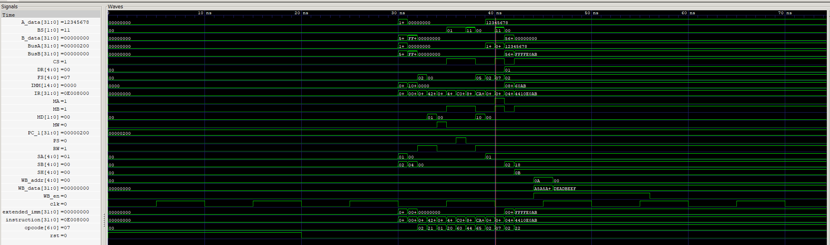
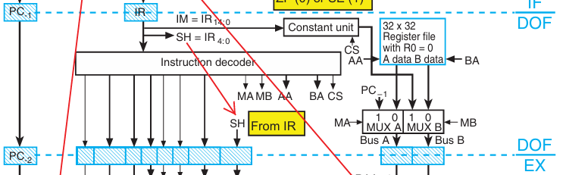
DOF Stage Unit Testbench

Slide 5
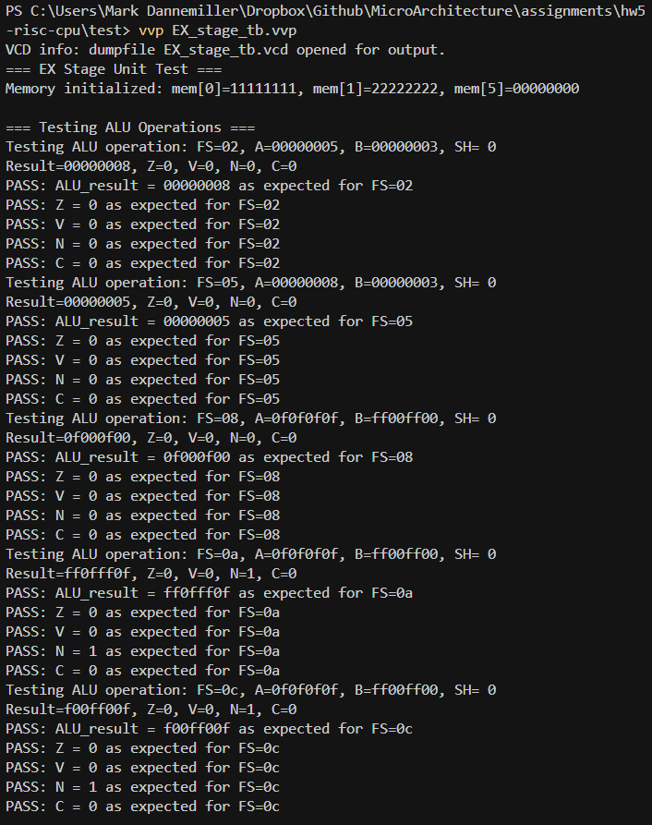
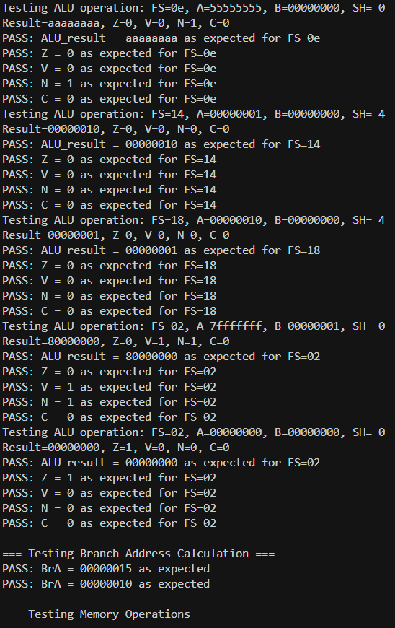
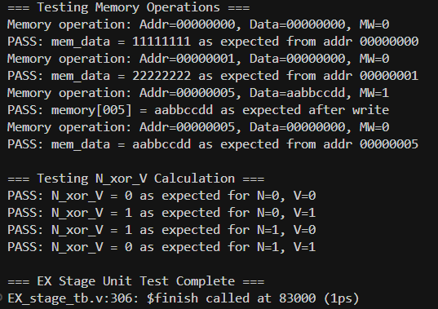
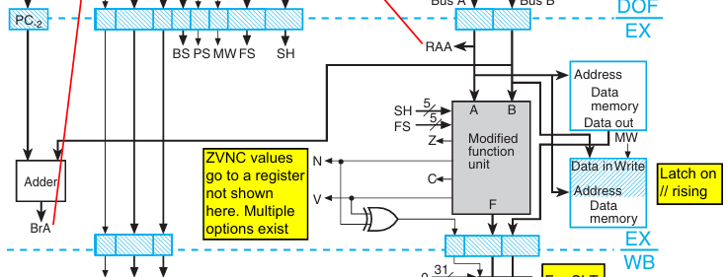
EX Stage Unit Testbench
ALU operations, branch address calculation, memory operations, N_xor_V calculation

Slide 6
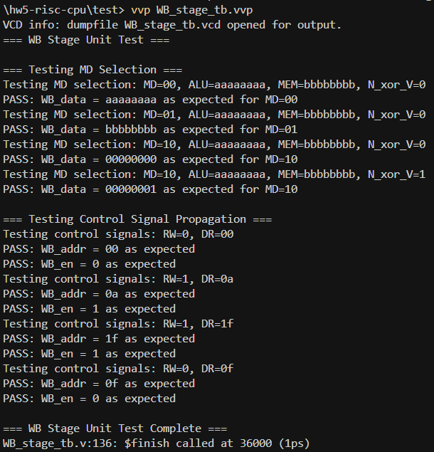
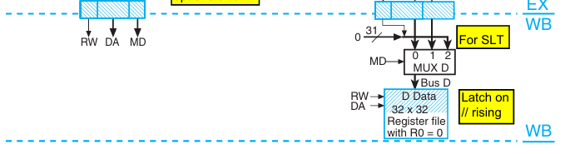
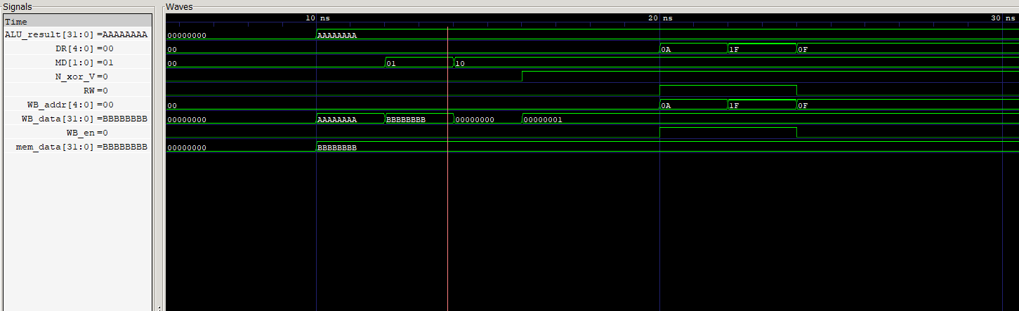
WB Stage Unit Testbench
MD Selection, Control signal propogation

Slide 7
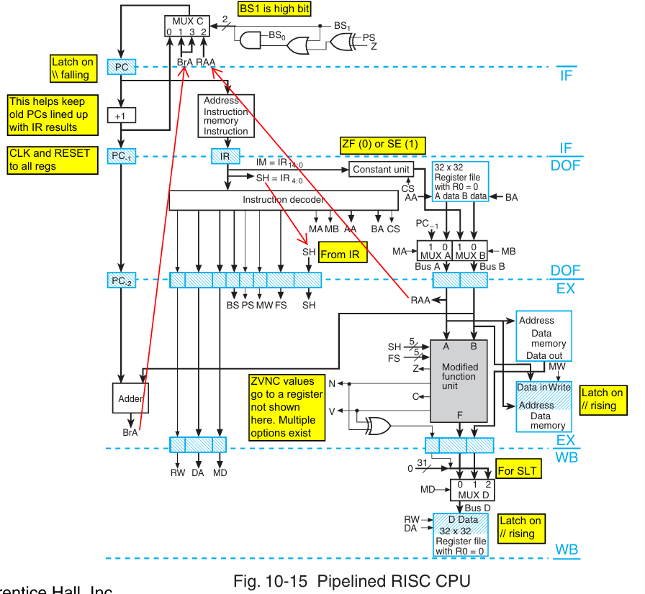
TOP Testbench
Phase 1: Pipeline Verification Test
Phase 2: Register Initialization and Basic Instruction Testing
Phase 3: Memory Operations
Phase 4: Immediate Operations
Phase 5: Branch and Jump Operations

Slide 8
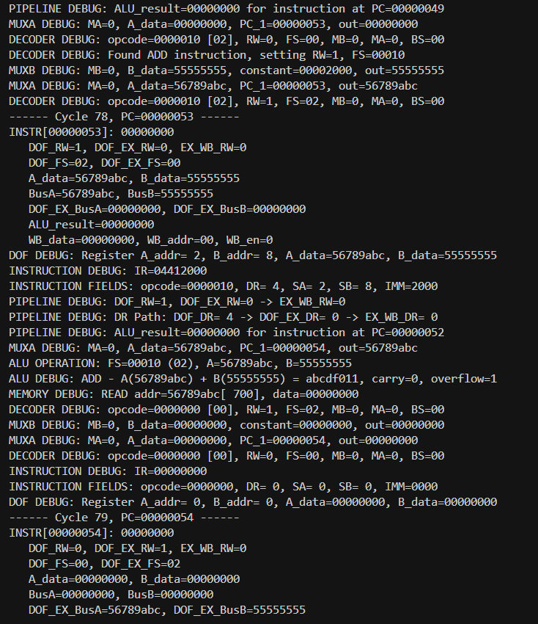
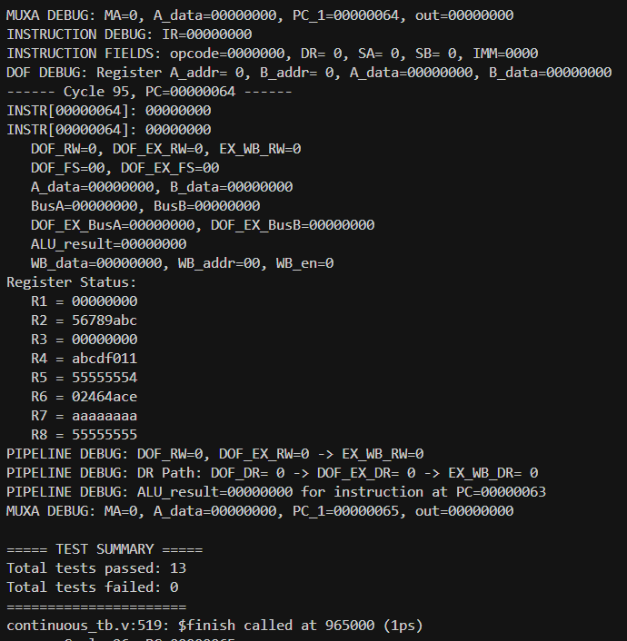
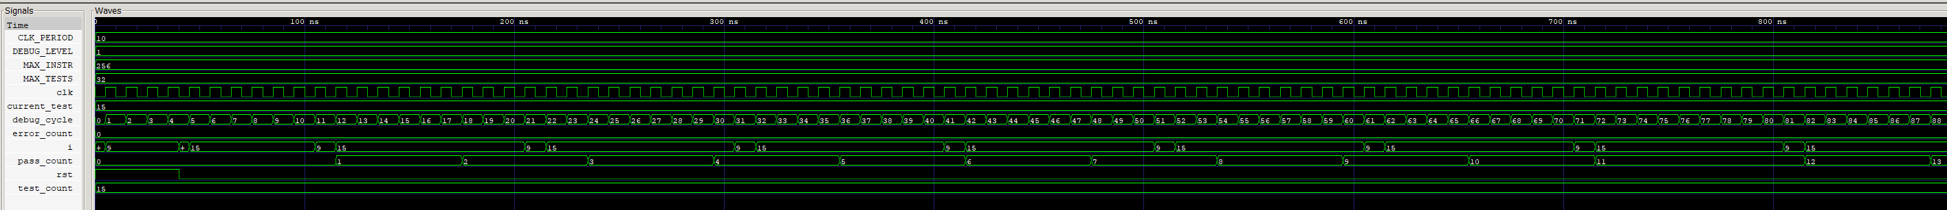
TOP Testbench (continuous_tb.v)

